Slide 1
Shortest Path Problem
Lucas Hasting
Ethan Nix
Krutivas Pradhan

Slide 2
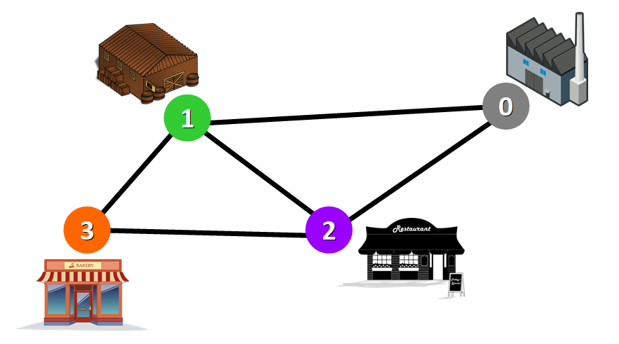
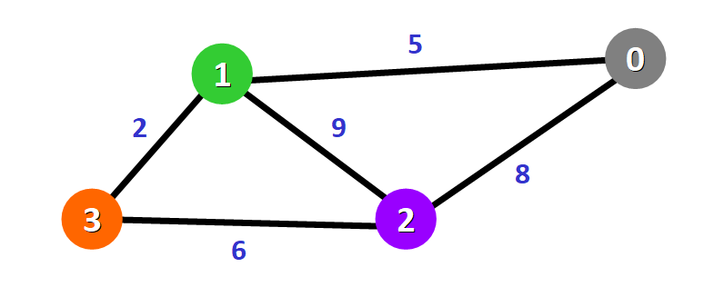
What is the Shortest Path Problem?
The single-source shortest path problem, in which we have to find shortest paths from a source vertex v to all other vertices in the graph.
The single-destination shortest path problem, in which we have to find shortest paths from all vertices in the directed graph to a single destination vertex v.
The all-pairs shortest path problem, in which we have to find shortest paths between every pair of vertices v, v' in the graph.

Slide 3
Real World Application
Our real world application demonstrates a map system that shows roads and buildings and will allow the user to find the shortest path between two buildings of their choosing

Slide 4
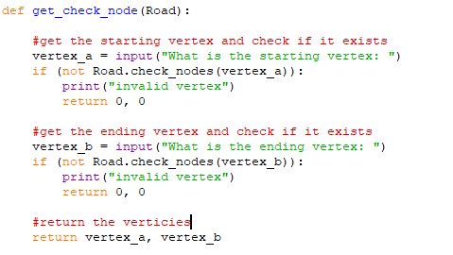
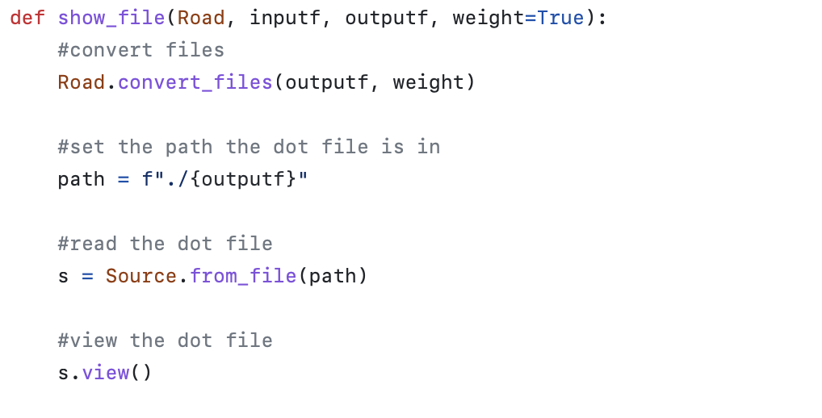
Front-End Code

Slide 5
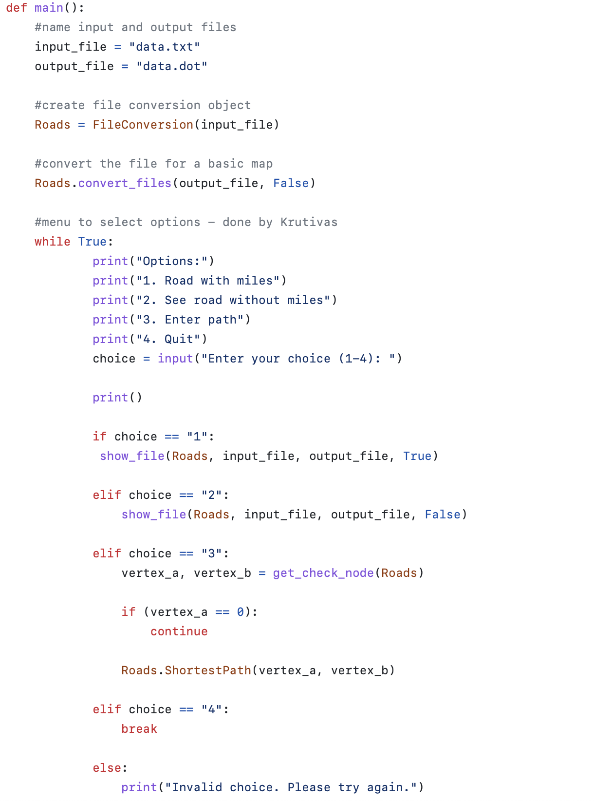
Front-End Code

Slide 6
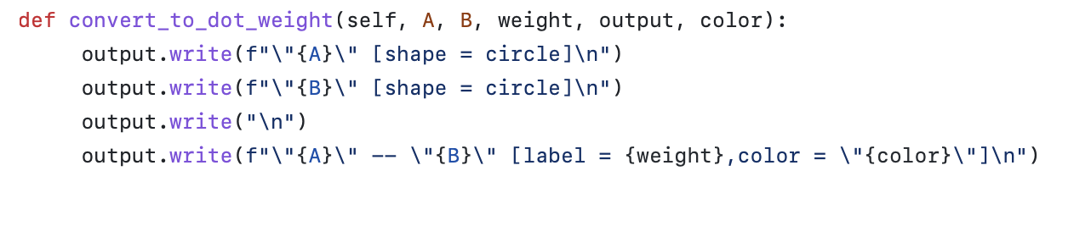
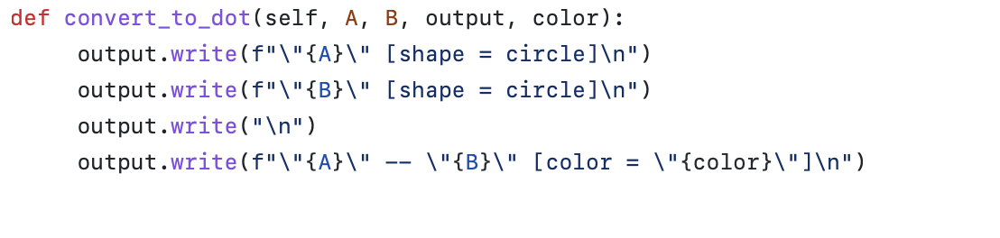
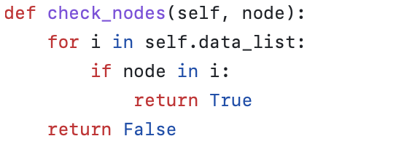
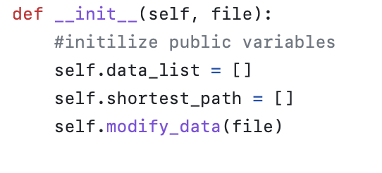
Back-End Code

Slide 7
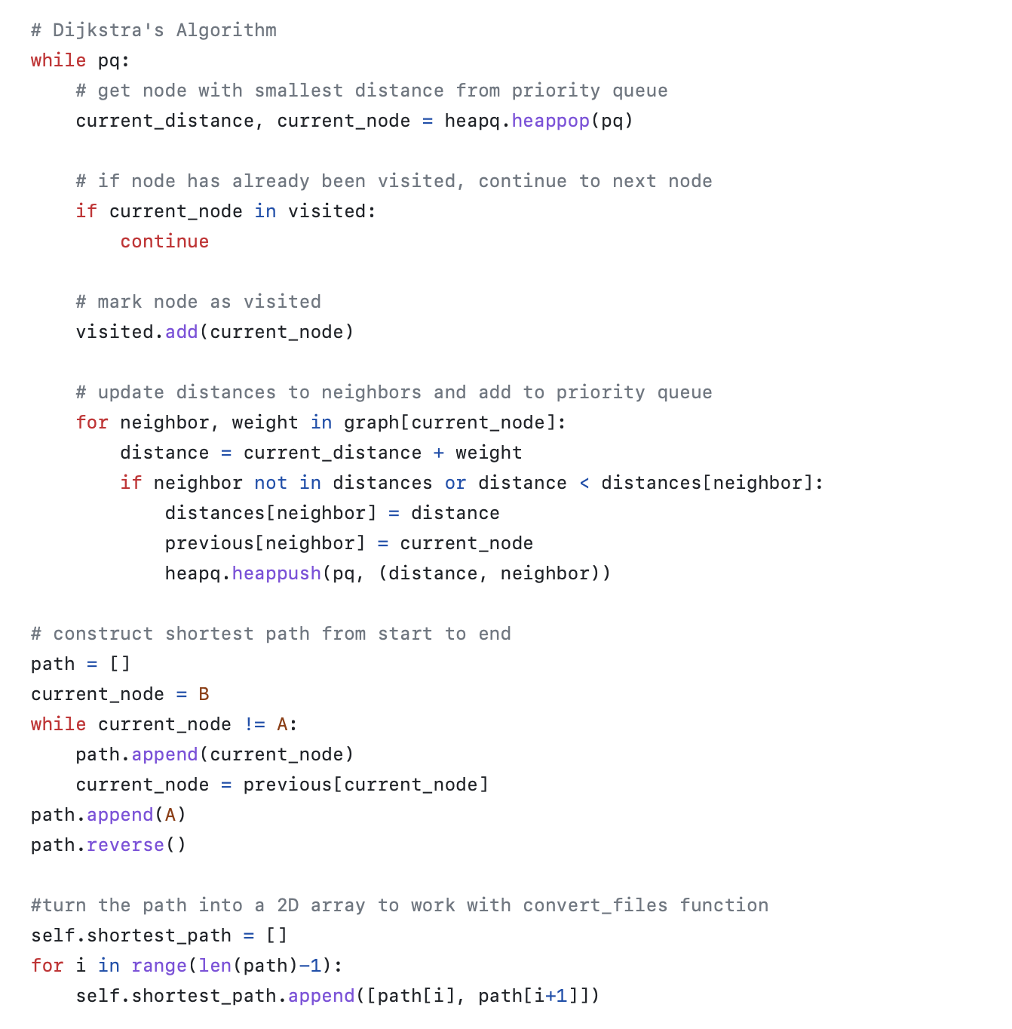
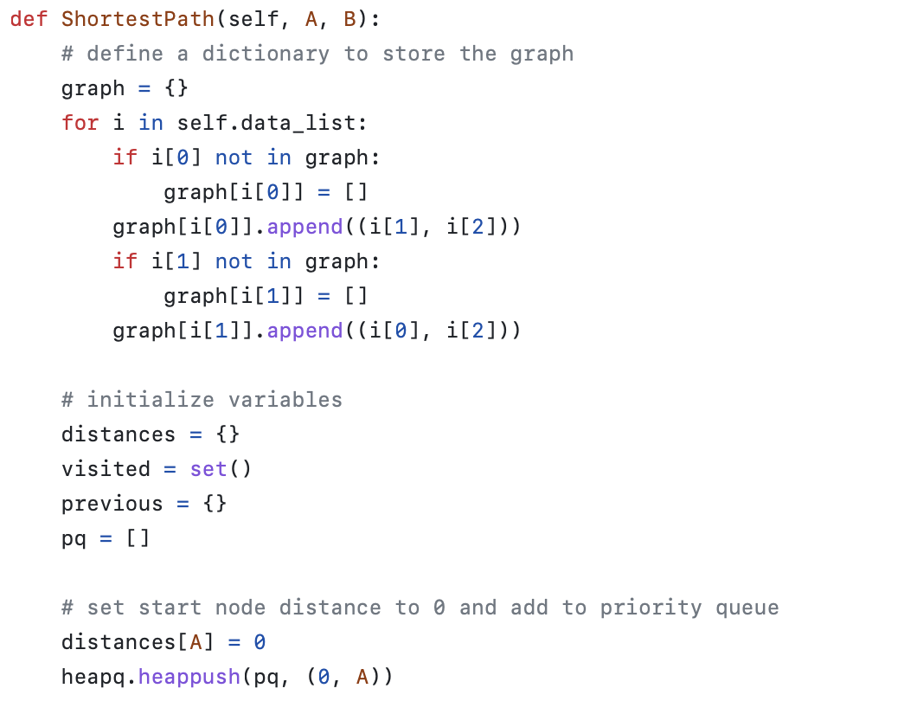
Back-End Code
Notes:
Ethan

Slide 8
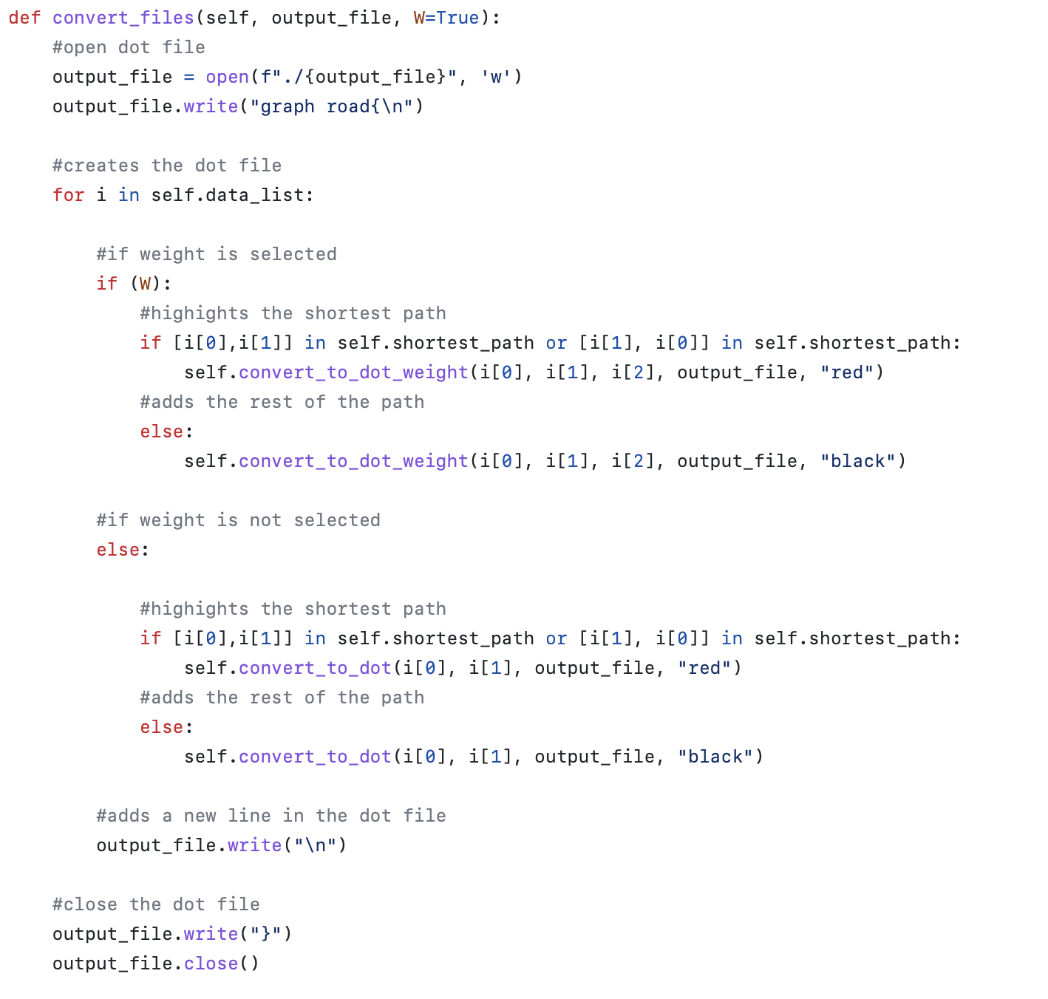
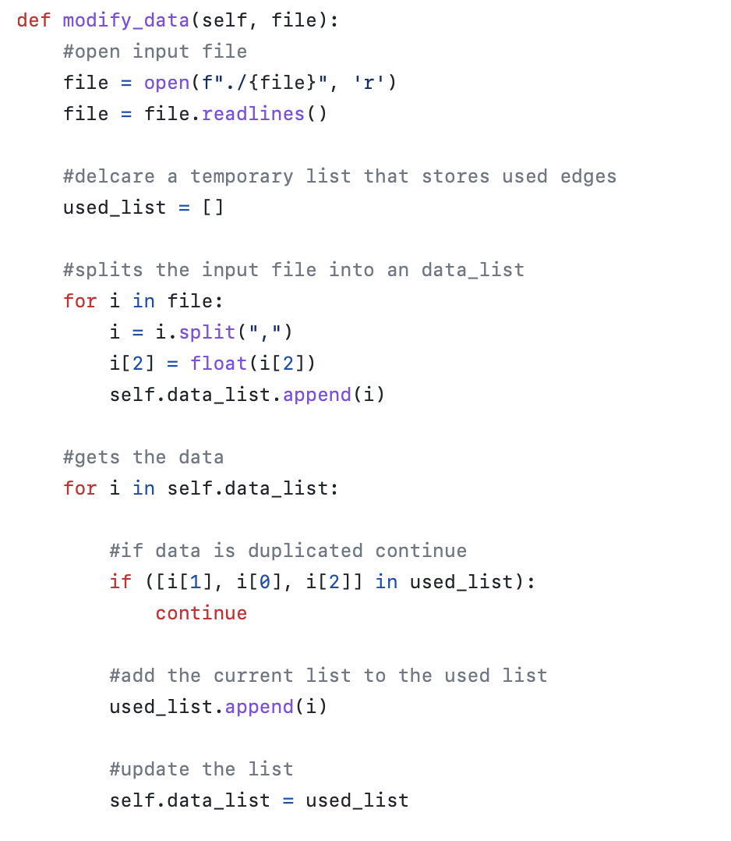
Back-End Code

Slide 9
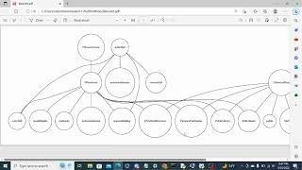
Front-End Experience (Video)

Slide 10
Sources
https://en.wikipedia.org/wiki/Shortest_path_problem
https://www.geeksforgeeks.org/python-call-function-from-another-file/
https://www.geeksforgeeks.org/python-pil-image-open-method/s
https://stackoverflow.com/questions/41942109/plotting-the-digraph-with-graphviz-in-python-from-dot-file
https://www.stat.auckland.ac.nz/~paul/Reports/gridGraphviz/examples/example4.html
https://graphviz.org/
https://www.w3schools.com/python/python_file_write.asp
https://www.geeksforgeeks.org/python-remove-all-values-from-a-list-present-in-other-list/
https://www.freecodecamp.org/news/dijkstras-shortest-path-algorithm-visual-introduction/
https://docs.python.org/3/library/heapq.html

Slide 11


